Slide 1
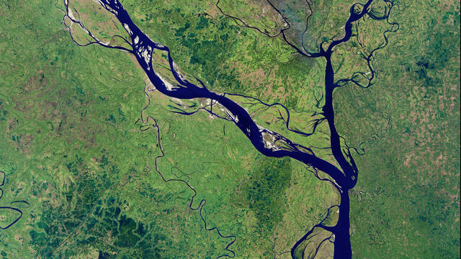

River Path Change Detection using Satellite Images
Vishwakarma Institute of Technology, Pune
Computer Vision – TY D 2023
CV CP PID 33
Prensented By :
Mandar Patil (58)
Prathamesh Saraf (66)
Department of E&TC Engineering
Guided By :
Prof. Jyoti Madake

Slide 2
Contents…
Introduction
Dataset
Proposed Methodology
Objectives
Feature Calculations
Results
Future Work
Conclusion
References
Problem Statement
Literature Survey

Slide 3
Problem Statement
The change in the path of a river can cause severe environmental and ecological effects
Traditional methods of monitoring river paths are time-consuming and require a significant number of human resources.
Computer vision techniques can be used to automate this process and provide accurate and timely information.

Slide 4
Introduction
Rivers are essential for the sustenance of life and are an integral part of the environment.
Computer vision techniques can be used to automate the process of monitoring river paths.
To develop a system that can detect changes in the path of a river over time.

Slide 5
Literature Survey
# | Research Paper Title | Methodology
1 | River Change Detection System Using Google Earth Satellite Imagery | Multi-class Support Vector Machine, and change rules are applied to create a map of changes between 2004 and 2017.
2 | River classification and change detection from landsat images by using a river classification toolbox. | The study suggests that this tool could be utilized in other locations to effectively detect changes in rivers
3 | Analysis of the Morphological Changes of the River Padma Along Naria Upazila through Supervised Classification of Satellite Images | The study evaluate morphological change that occurred in Padma River, particularly in the Naria Upazila area, as a result of river erosion in 2018

Slide 6
Literature Survey
# | Research Paper Title | Methodology
1 | Riverbank changes along the Mekong River: Remote sensing detection in the Vientiane-Nong Khai area | The method involves the integration of multispectral images to obtain precise water extent information.
2 | Change detection of Jamuna River and its impact on the local settlements. | The study also employed both supervised and unsupervised classification algorithms with ArcGIS Pro 2.3.2 to detect changes in different types of land cover
3 | Evaluation of course change detection of Ramganga river using remote sensing and GIS | To observe the alterations in the course of the Ramganga River Uremote sensing and GIS technology.

Slide 7
Novelty
Use of high-resolution satellite imagery
Integration of multiple satellite images
Use of morphological operations
Application to other environmental monitoring scenarios

Slide 8
Satellite images with their Bands
Satellite images are typically composed of multiple bands, each of which represents a different portion of the electromagnetic spectrum.
The most recent Landsat satellite, Landsat 8, includes 11 bands
This are the most used band as per the requirements.
SR.NO | Band | Wavelength | Use of Band
1 | Coastal/Aerosol | 0.43-0.45 micrometres | shallow waters and measuring atmospheric aerosols
2 | Blue | 0.45-0.51 micrometres | water and vegetation for assessing land cover change
3 | Green | 0.53-0.59 micrometres | Vegetation for monitoring crop health
4 | Red | 0.64-0.67 micrometres | urban areas and mapping mineral deposits

Slide 9
Dataset Collection
Earth Explorer is a web-based tool provided by the United States Geological Survey (USGS).
Landsat imagery is often used for environmental monitoring.
Landsat data is widely available with historical imagery dating back to 1972.
For our approach we used Krishna River
We collect Images Data From 1994 to 2023

Slide 10
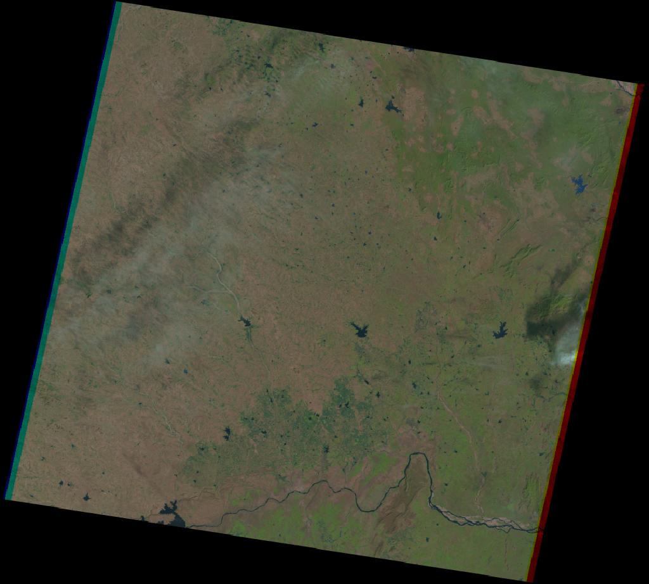
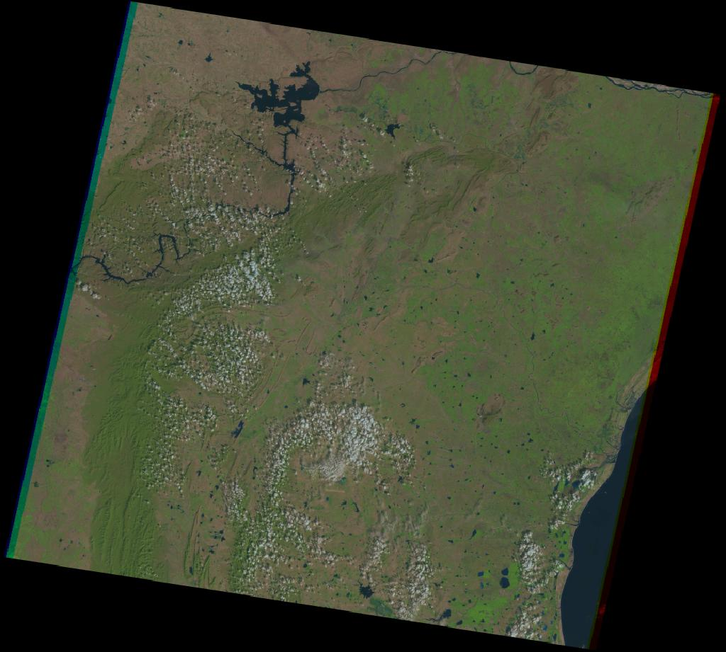
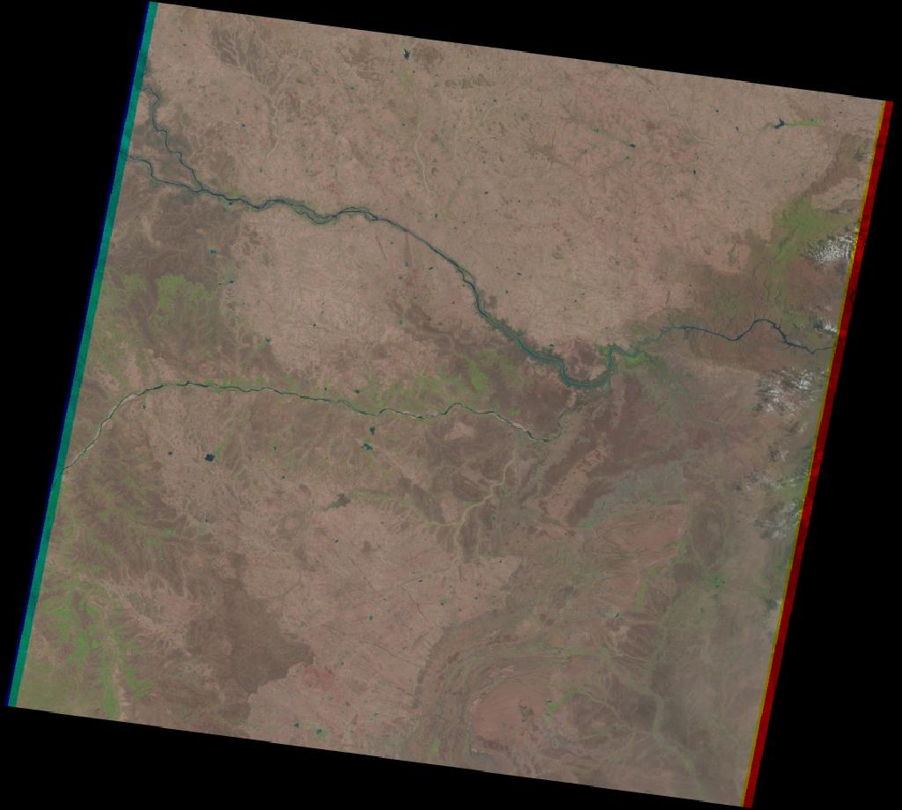
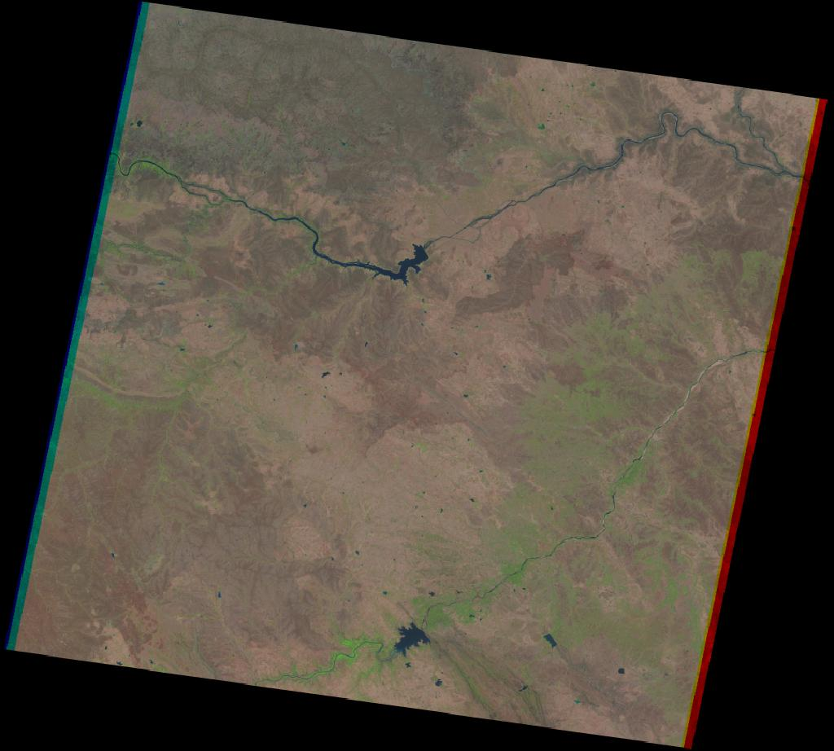
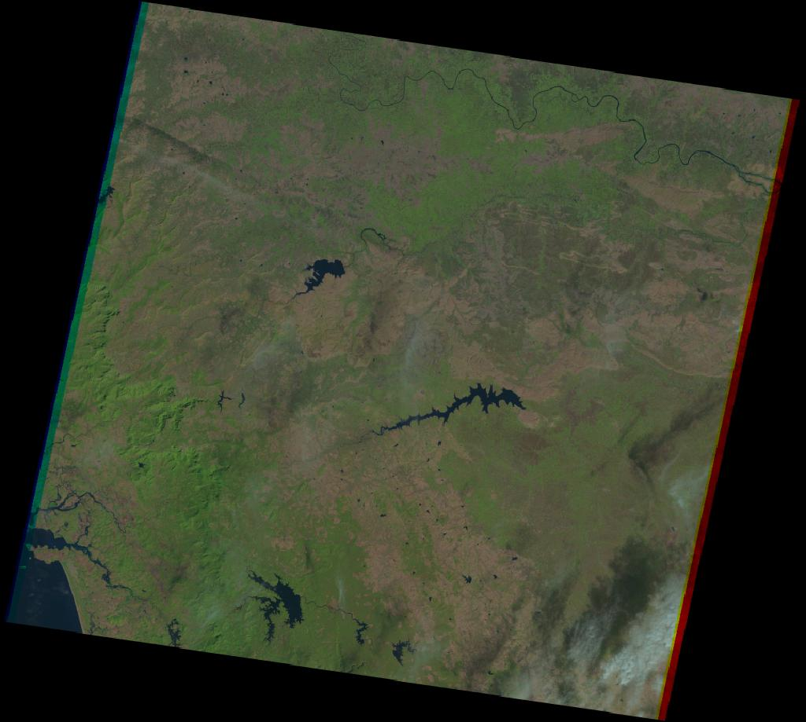
Krishna River
Path 143 row 48
Path 143 row 49
Path 144 row 49
Path 145 row 49
Path 146 row 49

Slide 11
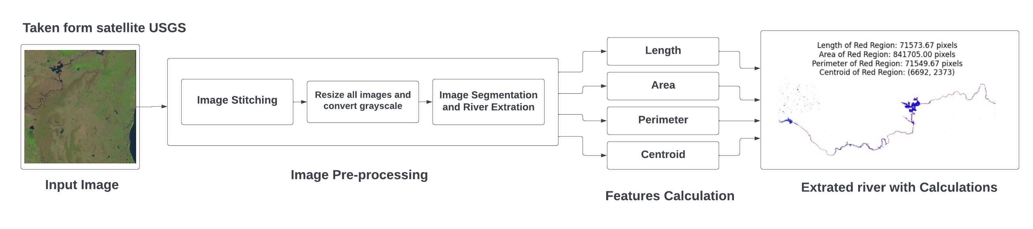
Proposed Methodology

Slide 12
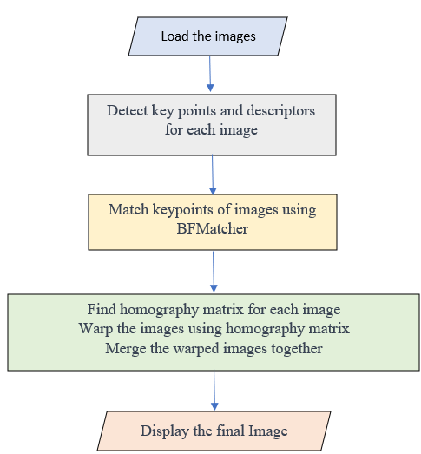
Image Stitching
So we used Two possible approach for Image Stitching
Using KNN Key feature matching Algorithm
Manual Stitching

Slide 13
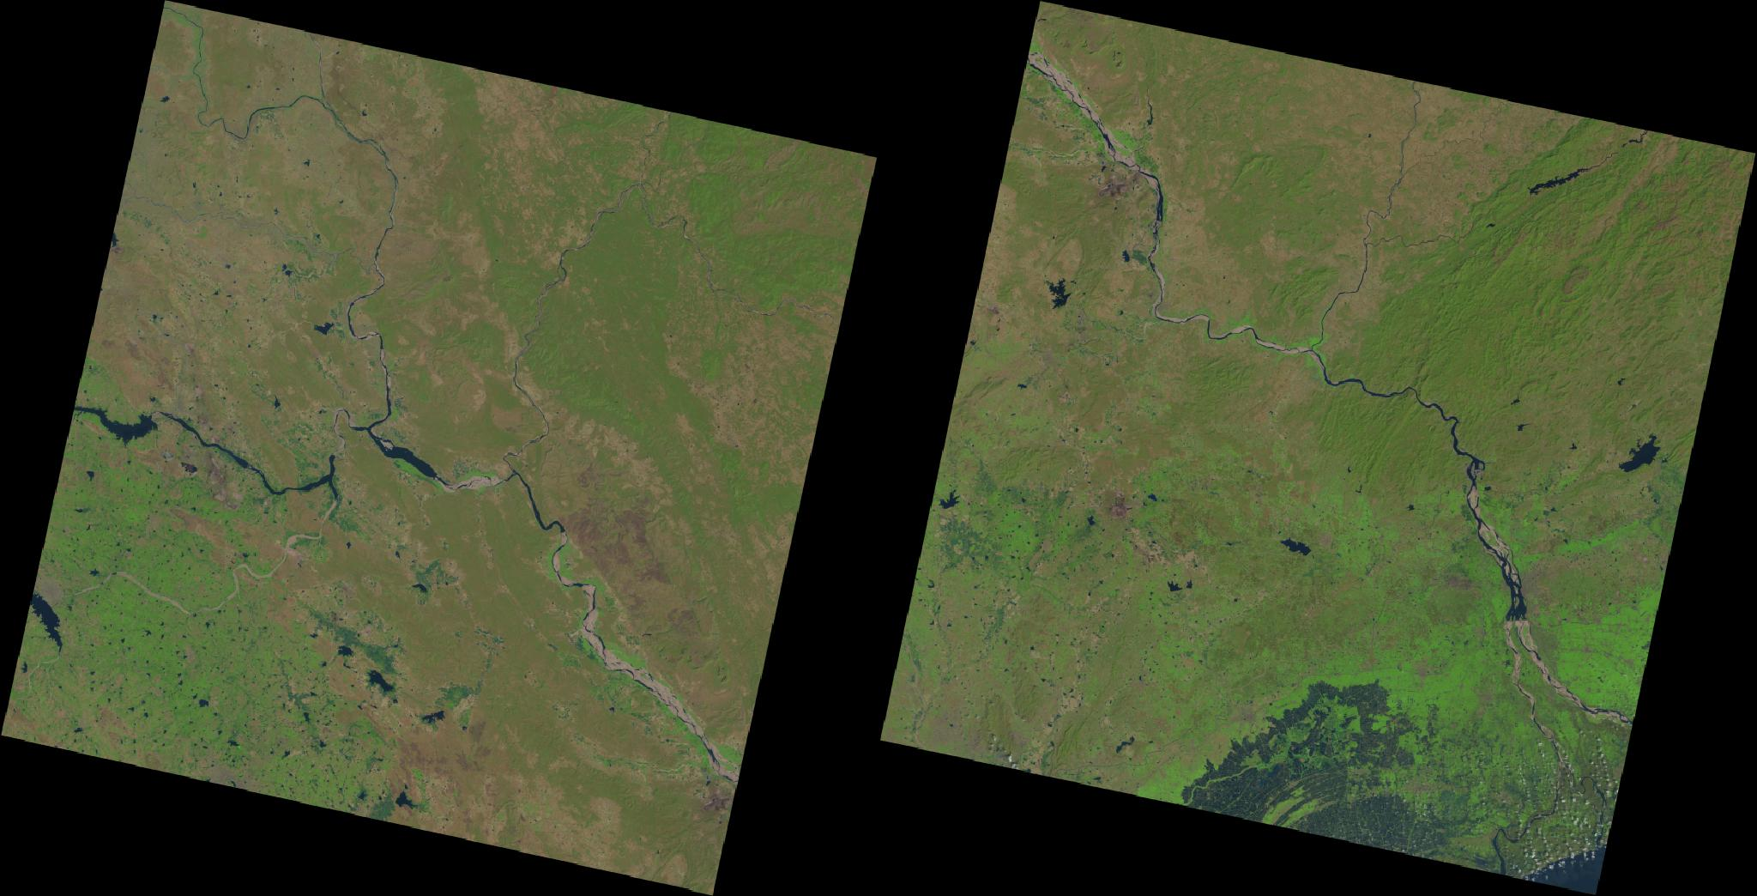
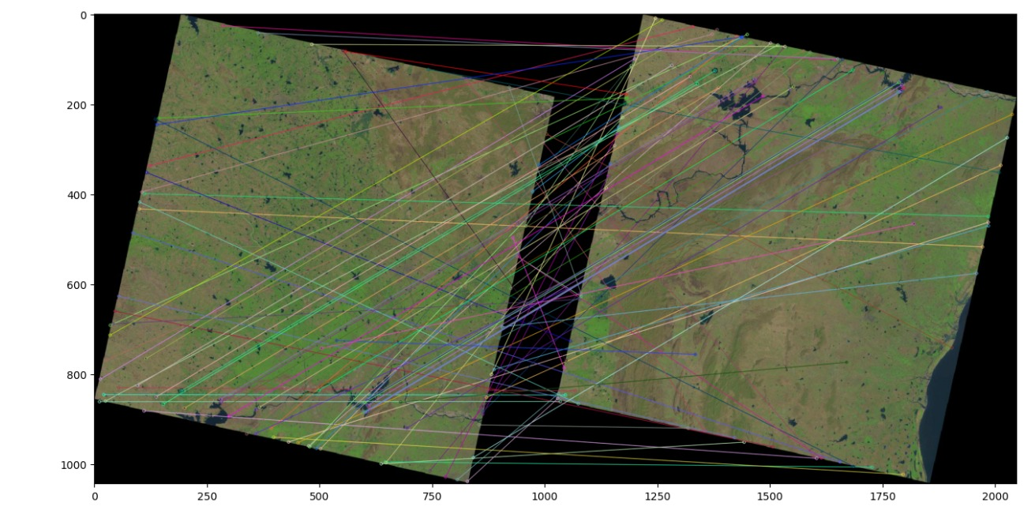
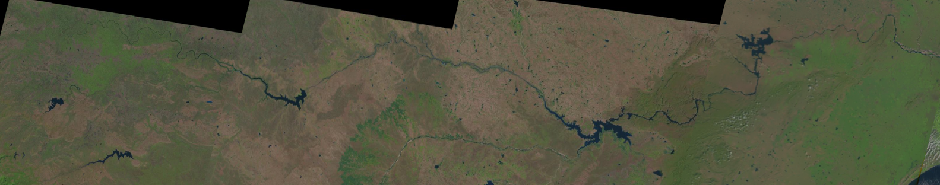
Process of Image Stitching
Input Image
Key-point Matching
Stitched Image

Slide 14
NDVI Process
Normalize Difference Vegetation Index
It is used to quantify vegetation greenness it is used for understand vegetation density
For NDVI Process QGIS (Quantum Geographic Information System) Application
Band 4: 655- 670 nm (wavelength), 449.4 - 434.9 THz (frequency). Band 5: 845- 885 nm (wavelength), 354.2 - 337.1 THz (frequency)
For extract blue part of image uses the formula NDVI = (NIR – Blue) / (NIR + Blue) that is NDVI (Landsat 8) = (B5 – B4) / (B5 + B4)

Slide 15
Image Segmentation
Image segmentation is the process of dividing an image into multiple segments or regions.
For our approach we used OTSU’s method
Uses separating the foreground and background regions in an image.

Slide 16
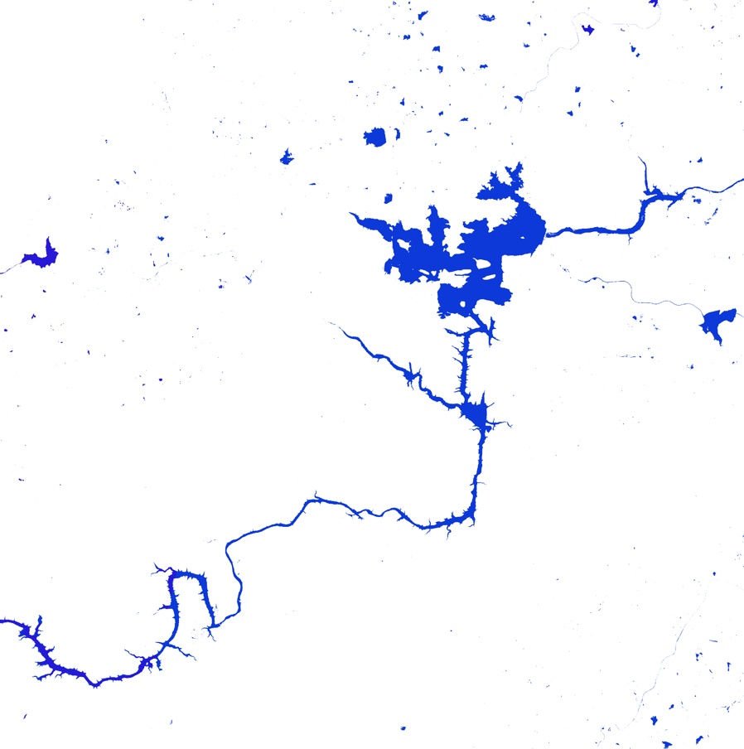
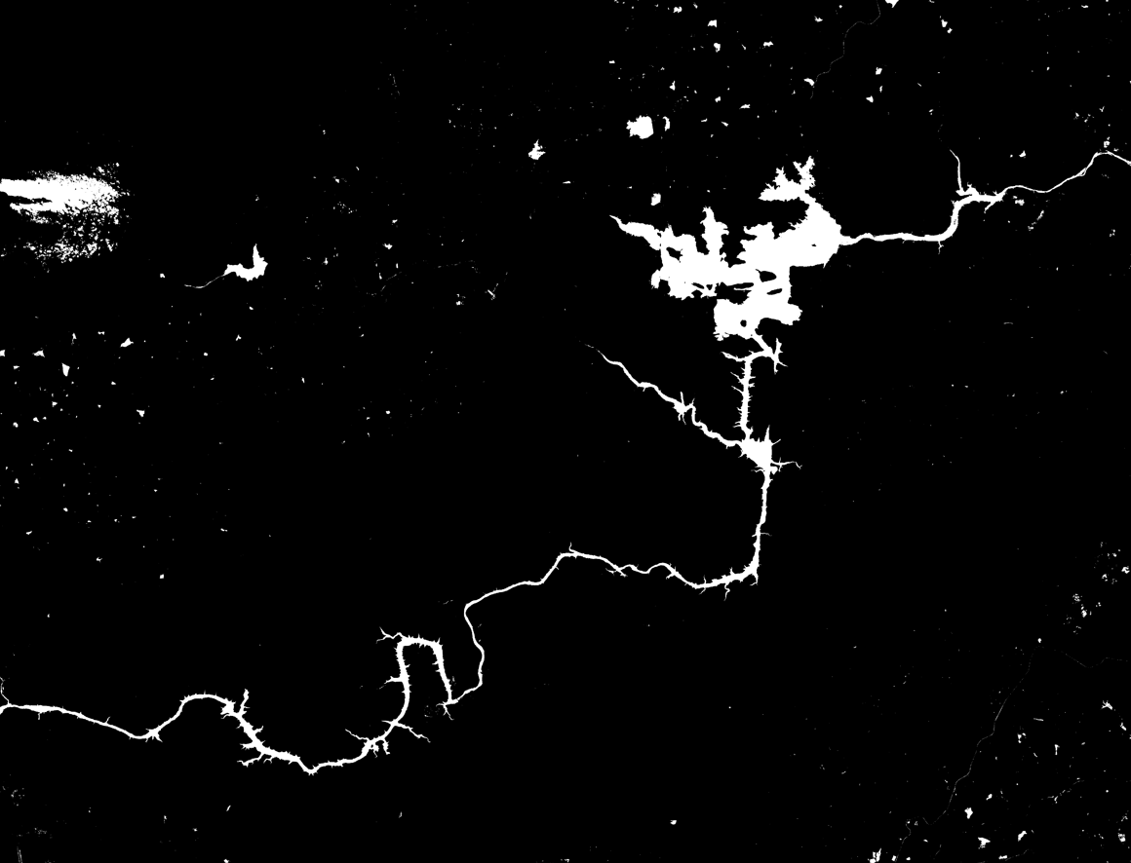
Outputs
Image Taken form QGIS Application
Segmented Image (Perform Thresholding)

Slide 17
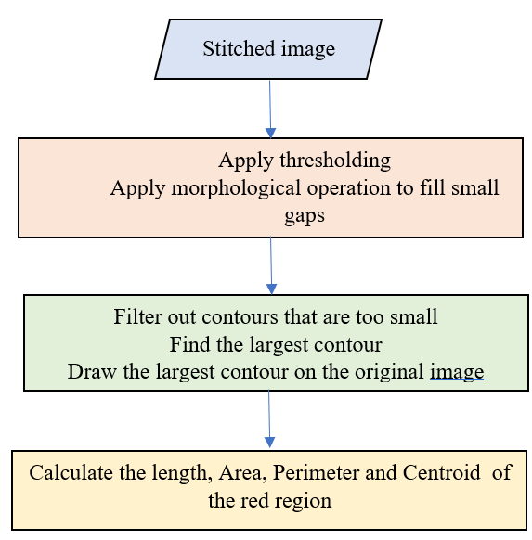
Morphological operations and Contour detection
In this case it is used to fill small gaps in the foreground regions of the image.
The operation works by dilating the image followed by an erosion.
Contour refers to a curve or a set of curves that forms the boundary of an object
Using cv2.findContours() function to find contours

Slide 18
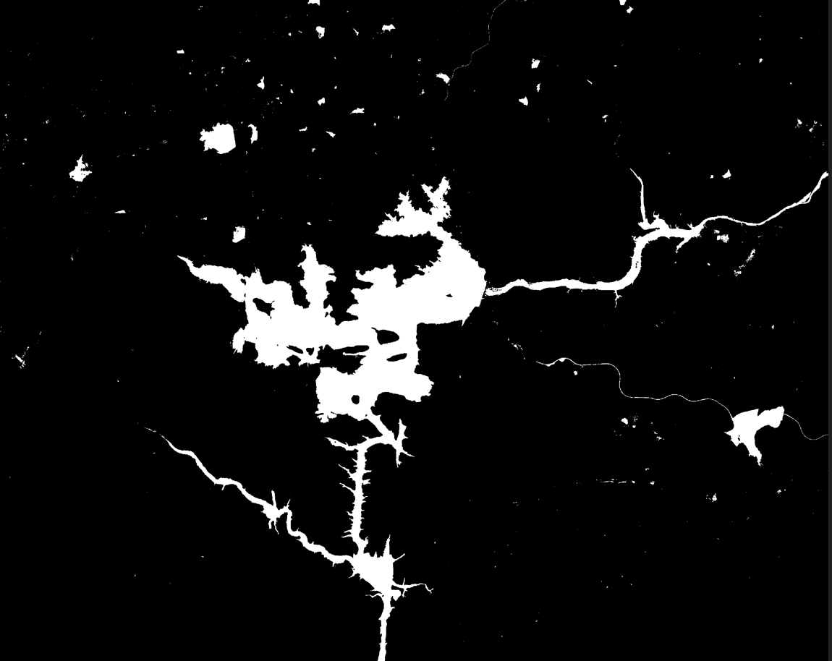
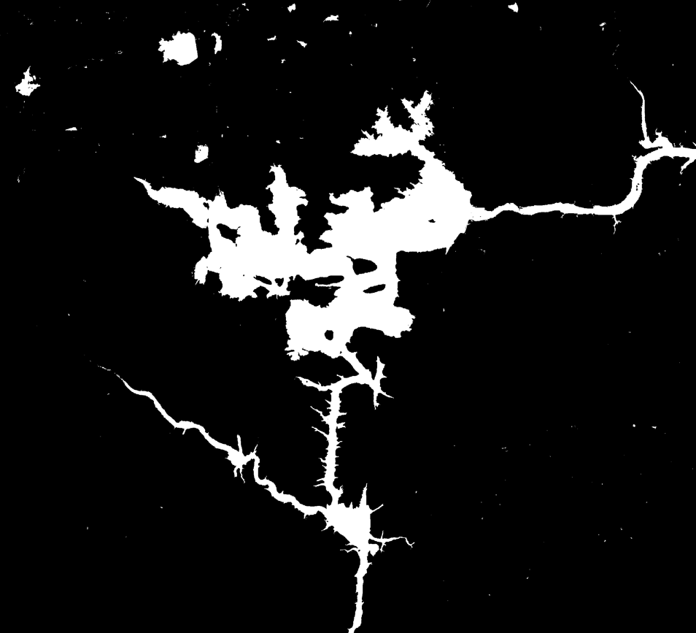

Output
Apply Morphological Operation on image

Slide 19
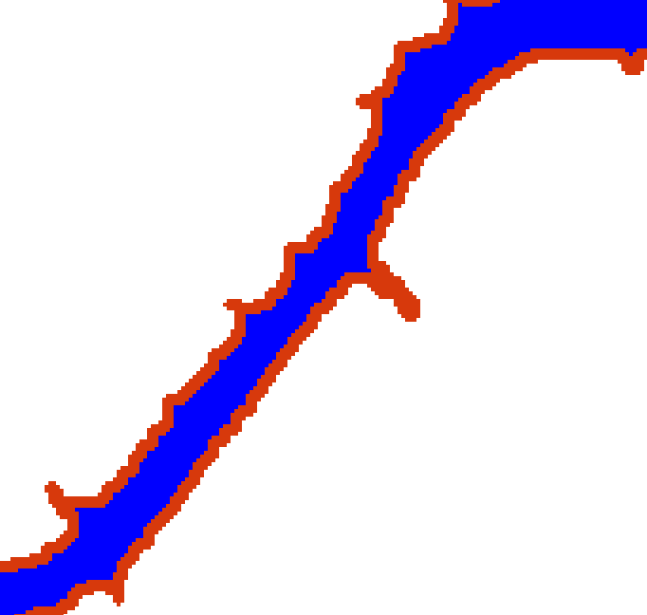
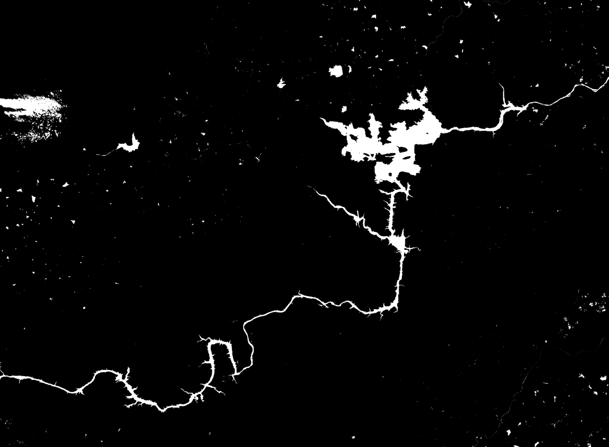
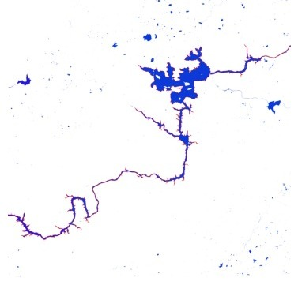
Output
Detected Contour
Draw contour on image

Slide 20
Calculations
Area : The area of the contour can be obtained using the shoelace function.
Área = 0.5 * |(x1*y2 + x2*y3 + ... + xn*y1) - (y1*x2 + y2*x3 + ... + yn*x1)|
Length : The length of the contour can be calculated by integrating the distance formula over the curve's domain when contour is Closed
Length = ∫ sqrt(1 + (dy/dx)^2) dx

Slide 21
Calculations
Perimeter : The perimeter of the contour can be calculated by integrating the distance formula over the curve's domain when contour is Closed
Perimeter= ∫ sqrt(1 + (dy/dx)^2) dx
Centroid : The centroid of the contour can be calculated using the moments of the contour.
M00 = ΣΣ I(x,y)
M10 = ΣΣ x*I(x,y)
M01 = ΣΣ y*I(x,y)
M11 = ΣΣ x*y*I(x,y)
M20 = ΣΣ x^2*I(x,y)
M02 = ΣΣ y^2*I(x,y)

Slide 22
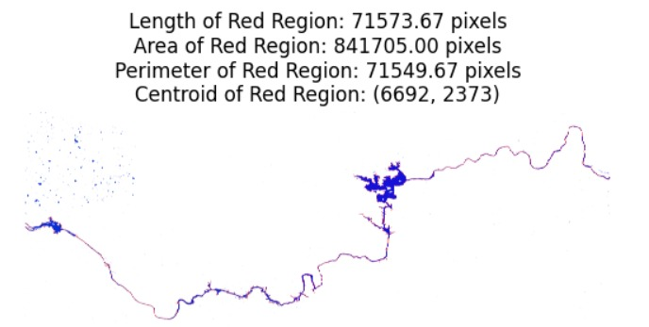
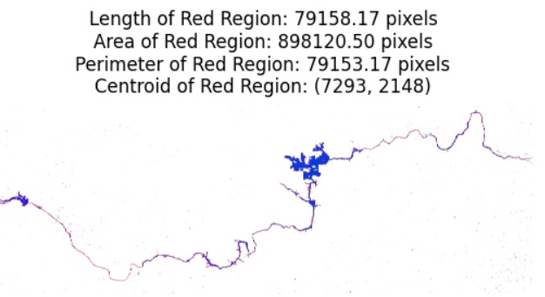
Results
Year 2023
Year 2018

Slide 23
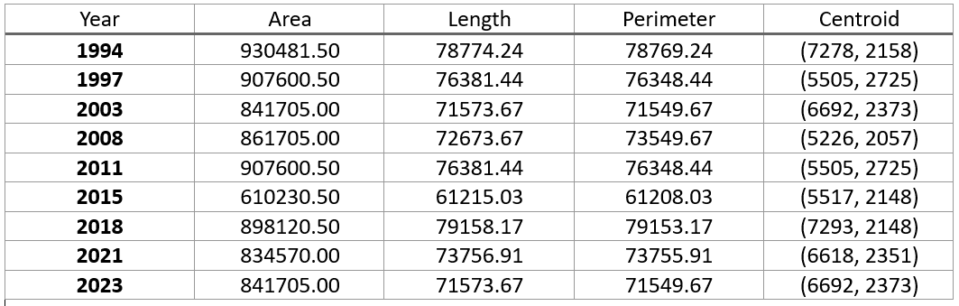
Parameter’s Table (all values in pixel)

Slide 24

Conclusion
River Path Change Detection is an effective approach to analyze satellite images and detect changes in river paths.
This method involves stitching images, thresholding, and contour detection followed by morphological operations to representing the river.
By calculating the properties of the largest contour changes in the river path can be detected and analyzed.

Slide 25
References
[1] Lina Zhu, Jianqing Zhang, and Li Pa, “River Change Detection System Using Google Earth Satellite Imagery ”, Proceedings of the First International Multi-Symposiums on Computer and Computational Sciences (IMSCCS'06), IEEE, 2006.
[2] Puttinaovarat, Supattra & Saeliw, Aekarat & Pruitikanee, Siwipa & Kongcharoen, Jinda & Chai-Arayalert, Supaporn & Khaimook, Kanit & Horkaew, Paramate. (2021). River classification and change detection from landsat images by using a river classification toolbox. IAES International Journal of Artificial Intelligence (IJ-AI). 10. 948-959. 10.11591/ijai.v10.i4.pp948-959.
[3] R. Titlee, M. S. Islam and N. Ahmed, "Analysis of the Morphological Changes of the River Padma Along Naria Upazila through Supervised Classification of Satellite Images," 2020 2nd International Conference on Advanced Information and Communication Technology (ICAICT), Dhaka, Bangladesh, 2020, pp. 302-307, doi: 10.1109/ICAICT51780.2020.9333474.
[4] Kummu, Matti & Lu, Xi Xi & Rasphone, Akchousanh & Sarkkula, Juha & Koponen, Jorma. (2008). Riverbank changes along the Mekong River: Remote sensing detection in the Vientiane-Nong Khai area. Quaternary International. 186. 100-112. 10.1016/j.quaint.2007.10.015
[5] Haque, Md & Shishir, Sharmin & Mazumder, Anannya & Iqbal, Mehedi. (2022). Change detection of Jamuna River and its impact on the local settlements. Physical Geography. 1-21. 10.1080/02723646.2022.2026075.
[6] Maurya, Satya & Yadav, Akhilesh. (2016). Evaluation of course change detection of Ramganga river using remote sensing and GIS, India. Weather and Climate Extremes. 13. 10.1016/j.wace.2016.08.001.

Slide 26

Thank You !

